Slide 1
Data analysis for Rockbuster Stealth
With special attention to geographical aspects

Slide 3
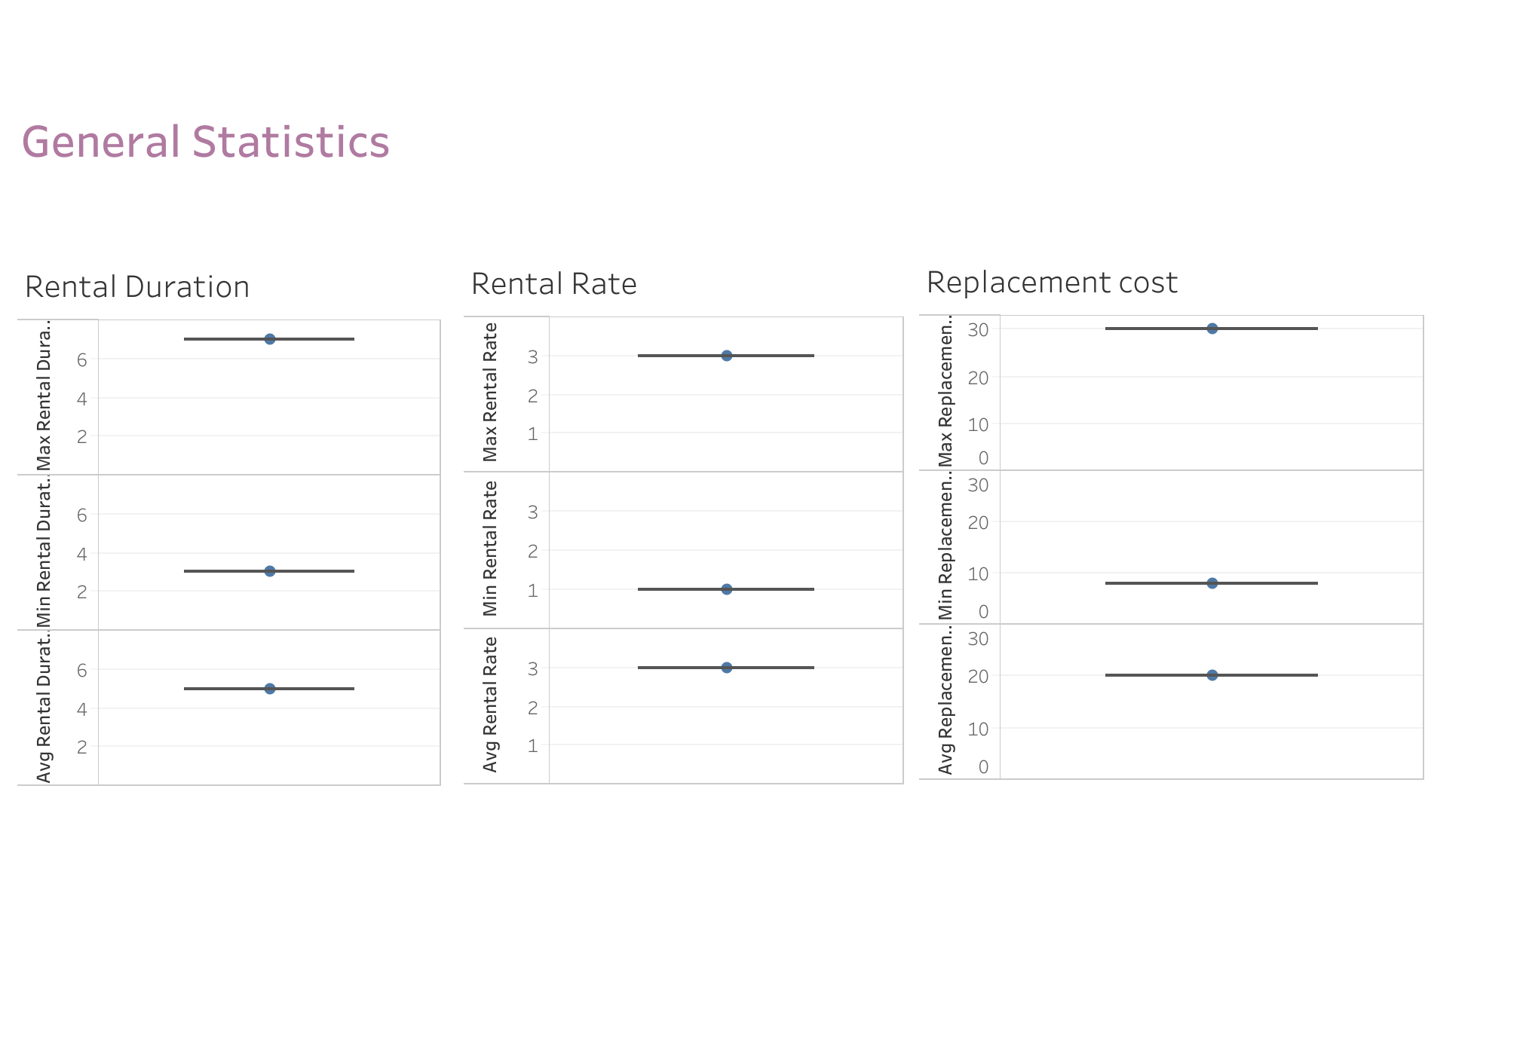

Slide 4
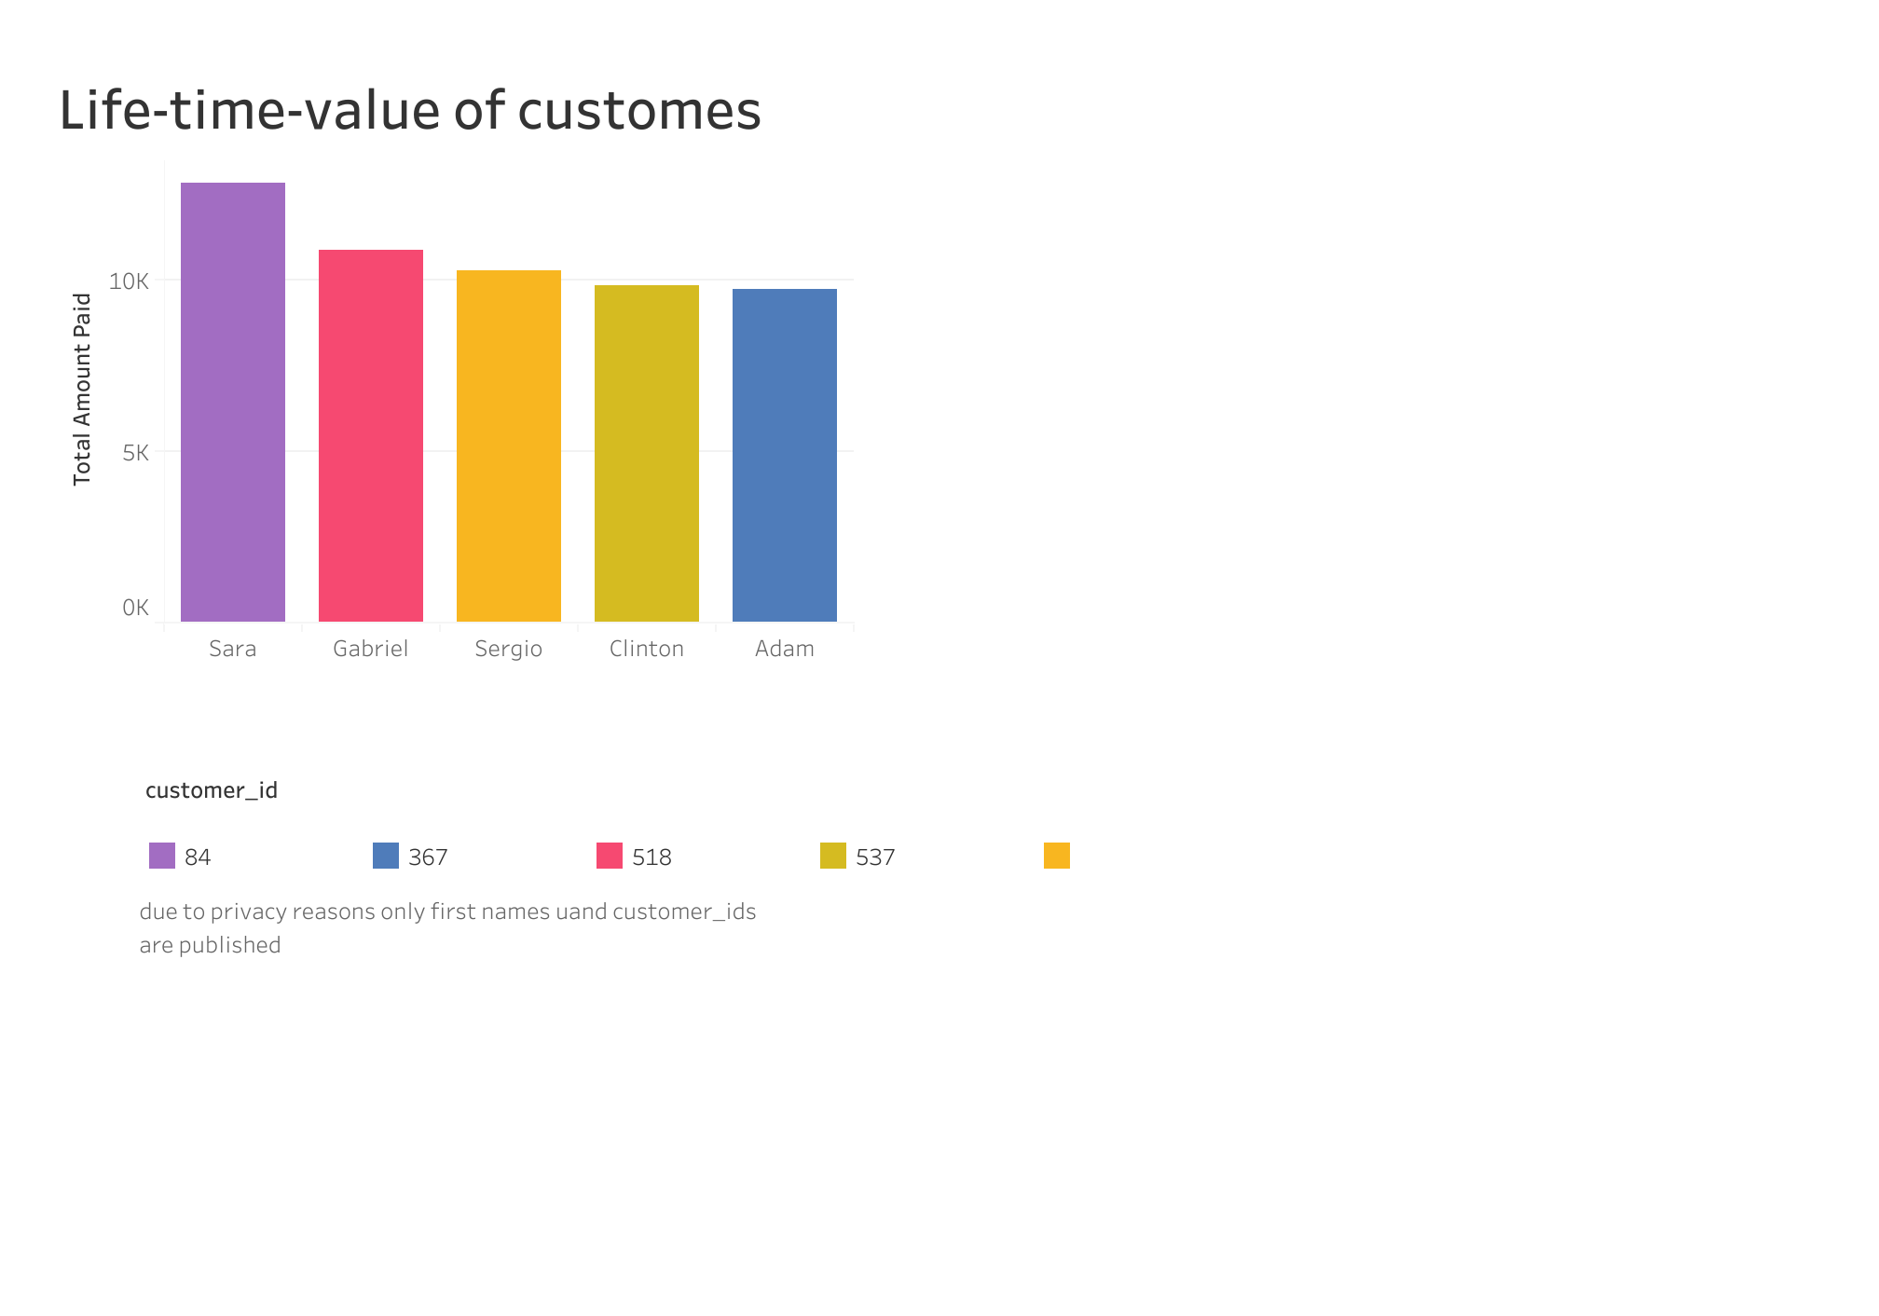

Slide 5
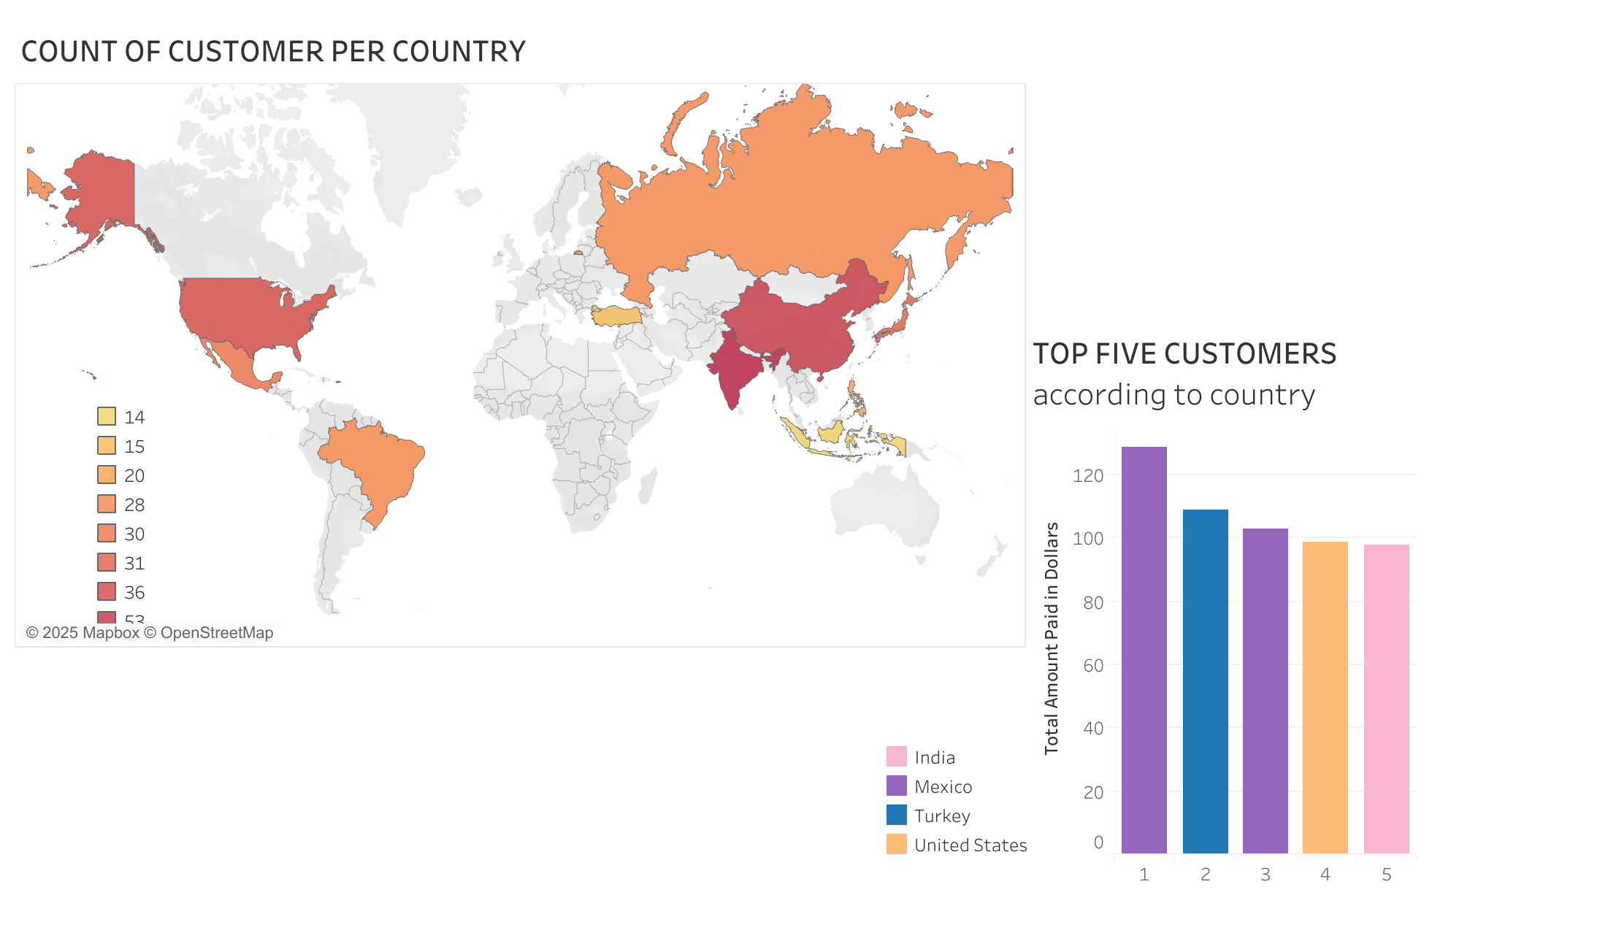

Slide 6
